Slide 1


SOCIAL BUZZ

Slide 2


Today's agenda
Project recap
Problem
The Analytics team
Process
Insights
Summary

Slide 3

Client overview:
Social Buzz, a social media platform focused on content over user identity
Over 500M monthly active users, posting 100,000+ pieces of content daily.
Objective:
Audit big data practices.
Identify the top 5 content categories with the largest aggregate popularity
Provide IPO readiness recommendations.
Key challenges:
Managing rapid growth and scaling operations.
Handling massive amounts of unstructured data.
Project Recap

Slide 4

Problem
Social Buzz’s rapid growth has outpaced its infrastructure capabilities.
The platform generates enormous amounts of unstructured data daily (text, images, videos, GIFs).
The company lacks prior experience with third-party firms for scaling and IPO preparation.

Slide 5



Andrew Fleming: Chief Technical Architect
The Analytics team
Marcus Romption: Senior Principal
Aswin P : Data Analyst

Slide 6
Process
1
Data understanding
2
Data Cleaning
3
Data Modeling
4
Data Analysis
5
Uncover Insights

Slide 7

Insights
Animals
1,897 posts
Unique Categories
16 unique categories
Month with Most Posts
January

Slide 8


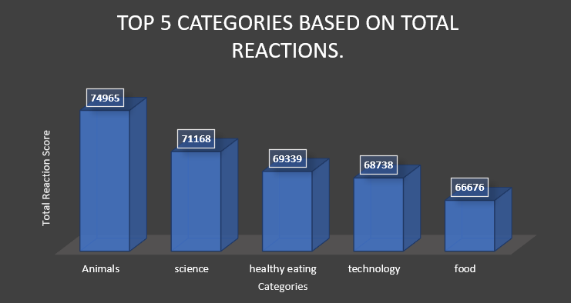

Slide 9
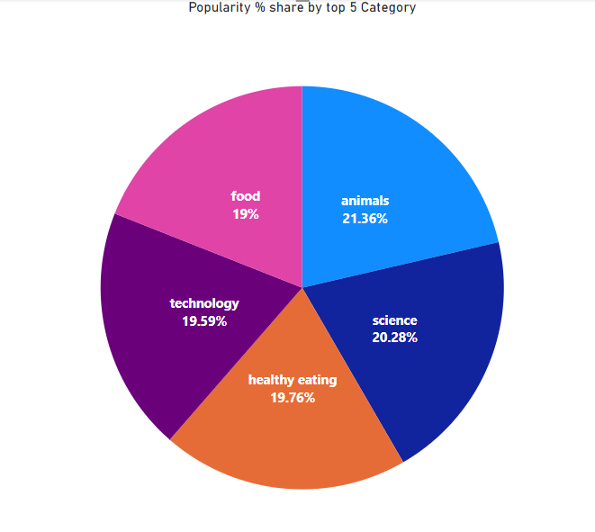

Slide 10
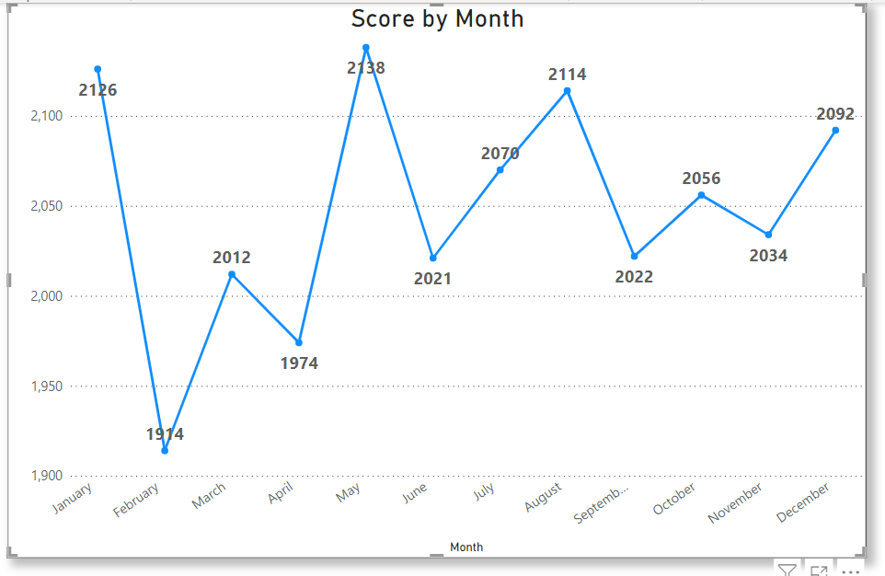

Slide 11

ANALYSIS
The most popular content categories are Animals and Science, indicating that audiences are drawn to ‘real-life’ and ‘factual’ topics. This highlights a preference for authentic and informative content over more entertainment-focused or fictional topics..
INSIGHT
Within the top 5 categories, "Healthy Eating" stands out as the most popular food-related topic. This shows a growing interest in health-conscious content among your audience. You can use this insight to create a targeted campaign that focuses on healthy eating, potentially collaborating with health-focused brands to increase user engagement..
NEXT STEPS
This ad-hoc analysis is insightful,but it’s time to take this analysis into large scale production for real-time understanding your business.
Summary

Slide 12
Thank you!
ANY QUESTIONS?

